Slide 1
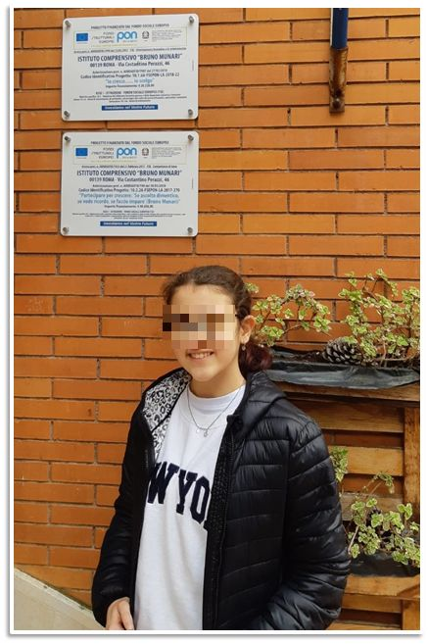
Hi! My name’s Sofia, I’m 13 years old, I live in Rome and I’m a student at the ‘Bruno Munari’ Middle School.
On Tuesday 28th February, I went to the ‘Viganò’ theatre with my class and my teachers to watch the play: ‘Sir Smith, Grammatical Horror’.

Slide 2
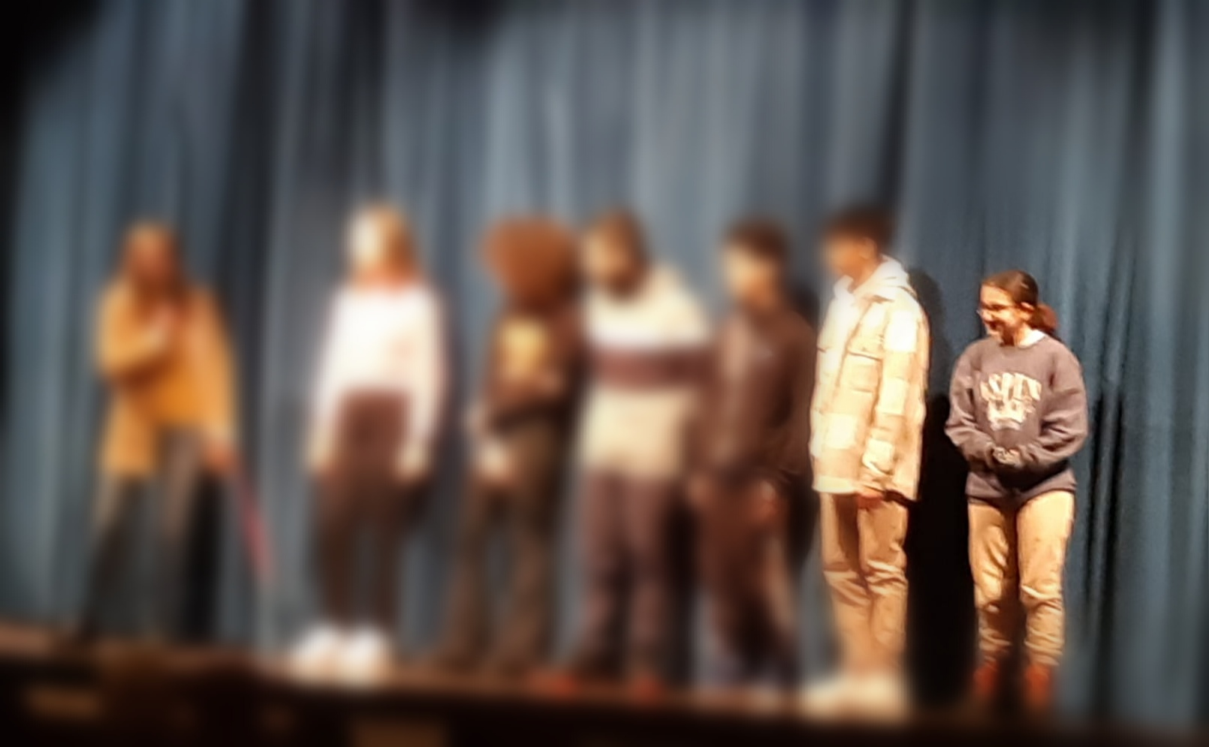
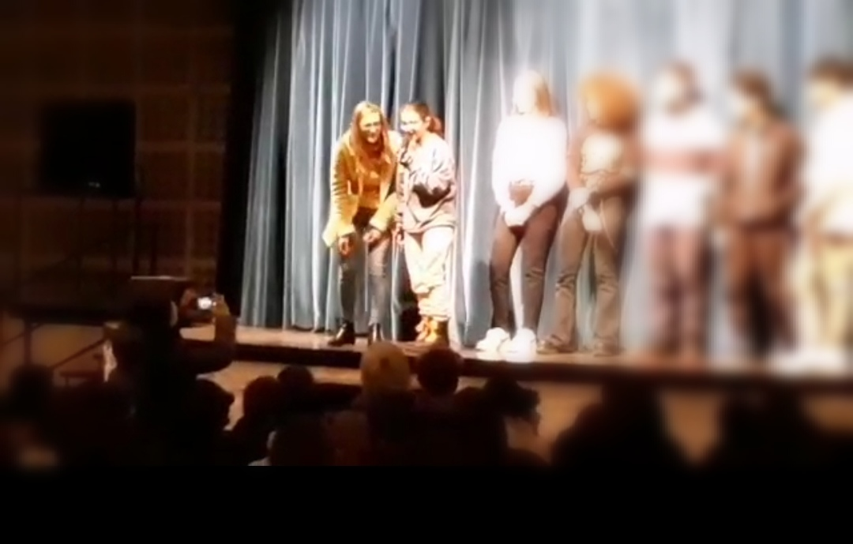

I got the chance to hop on the stage with other students from different schools; I was the youngest one.
We had to interact with the actors during the play.

Slide 3
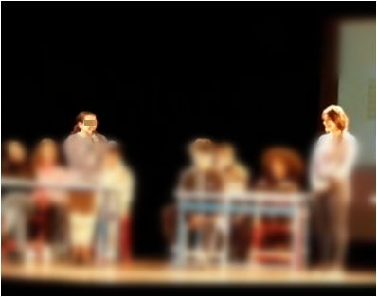
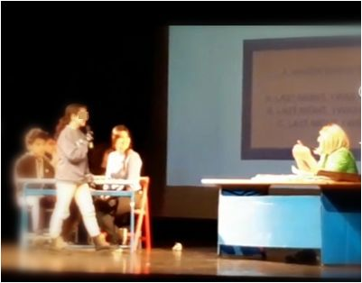
The play was set in a classroom
and I played the role of a student.
I pretended I was late at school…
I had a lot of fun!
There was also a pop quiz about English grammar and, then, something weird and a bit spooky happened… but I’m not going to spoil the plot!

Slide 4
That was a great experience!
I had a good time and the actors were awesome.
I’m a theatre lover so this was absolutely fantastic for me.
I want to thank the teachers and the school Principal for making it possible.
Goodbye!
Sofia

