Slide 1


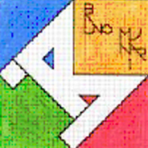

“COME WITH US” eTwinning PROJECT
TOPIC 1: SCHOOL AND TEACHERS
CLASSI TERZE - CARDINAL MASSAIA

Slide 2
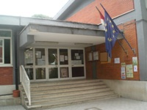
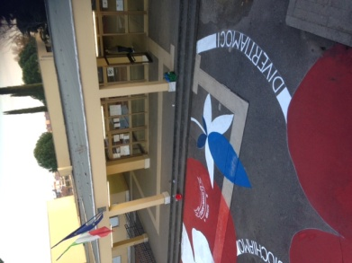
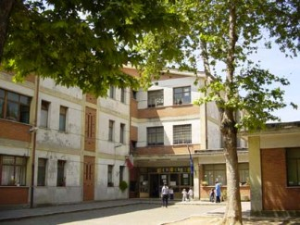
OUR SCHOOL
OUR SCHOOL IS VERY BIG. IT IS LOCATED IN ROME, ITALY.

Slide 3
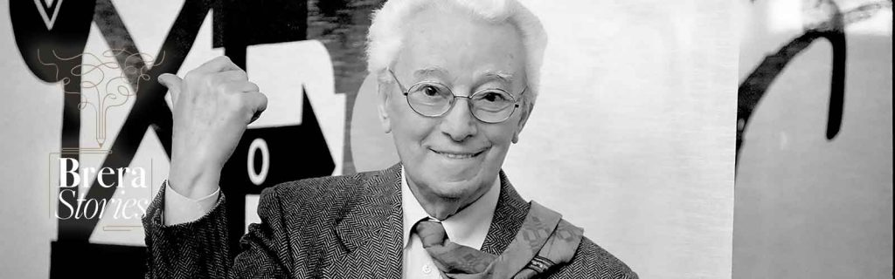
SCHOOL “BRUNO MUNARI”
THE NAME OF OUR SCHOOL IS “BRUNO MUNARI”. HE WAS AN ITALIAN ARTIST WHO WORKED IN DIFFERENT FIELDS (PAINTING, ARCHITECTURE,DESIGN). HE WROTE BOOKS FOR CHILDREN, TOO.

Slide 4
A PUBLIC SCHOOL
OUR SCHOOL IS A PUBLIC SCHOOL AND IT IS DIVIDED IN KINDERGARDEN, PRIMARY SCHOOL AND SECONDARY SCHOOL.

Slide 5
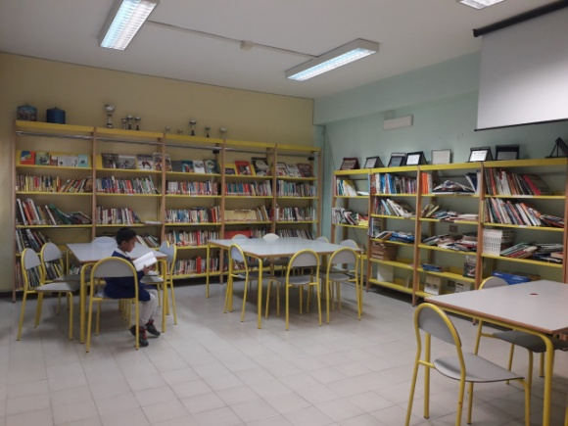
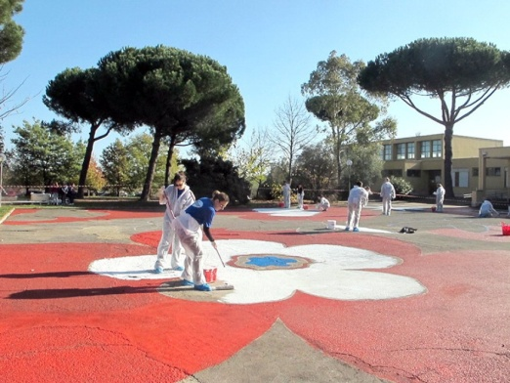
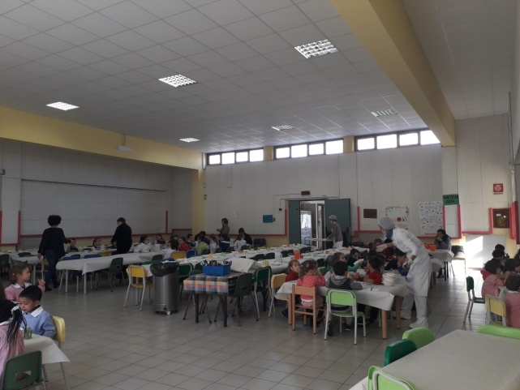
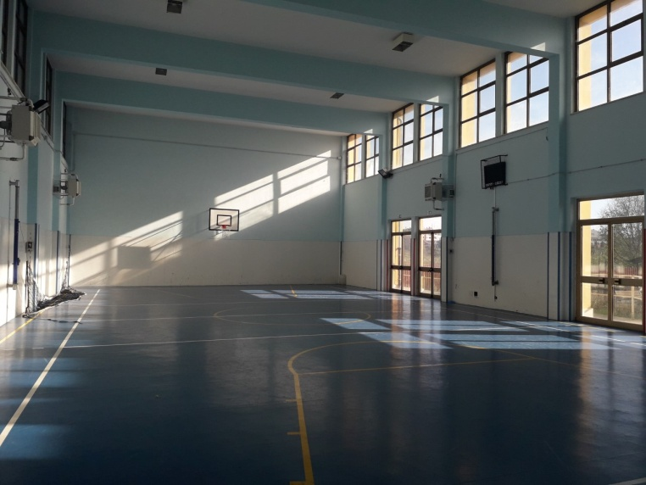
OUR SCHOOL PLACES
IN OUR SCHOOL THERE IS A CANTEEN, A GYM, A GARDEN, A LIBRARY AND MANY CLASSROOMS.

Slide 6
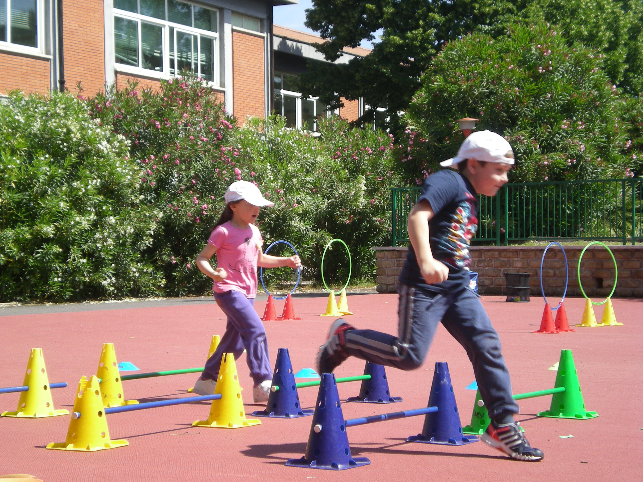
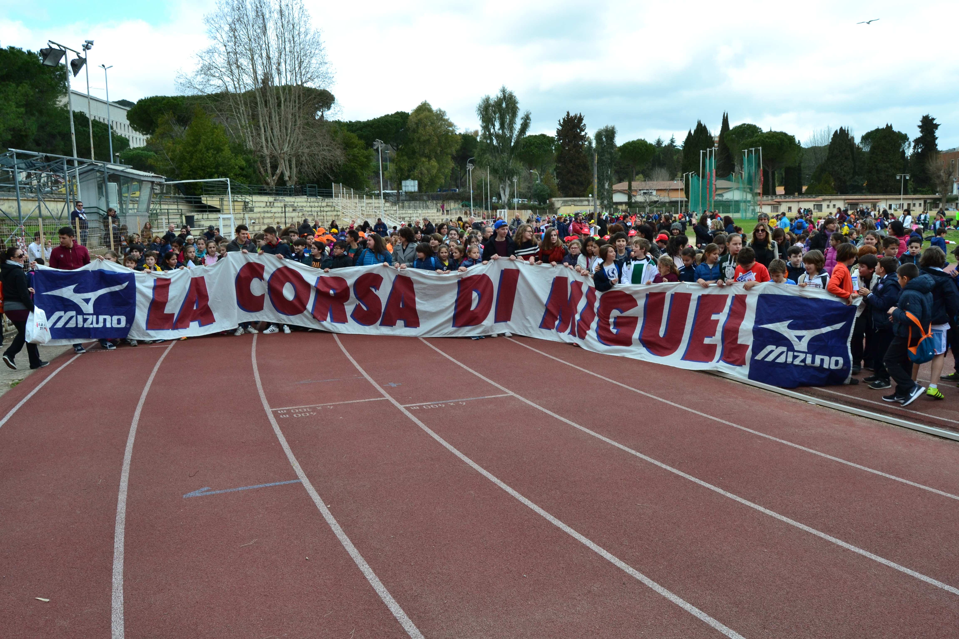
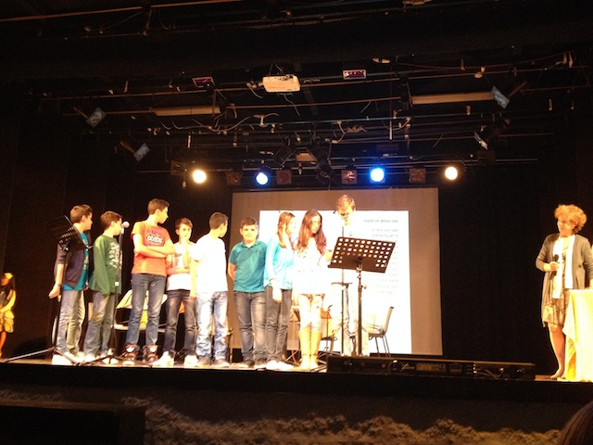
OUR SCHOOL PROJECTS
IN OUR SCHOOL THERE ARE MANY SCHOOL PROJECTS ABOUT DRAMA, MUSIC, READING, POETRY, AND SPORT COMPETITIONS.

Slide 7
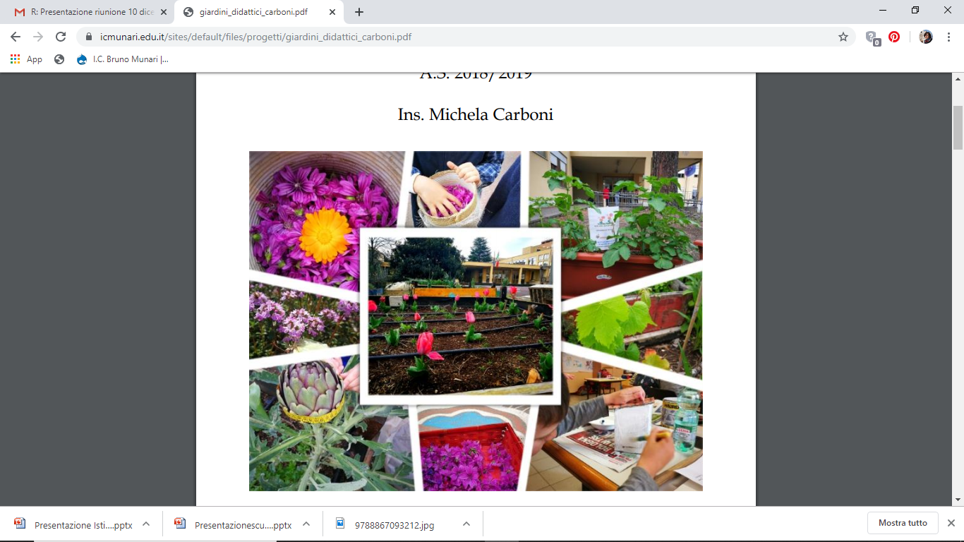
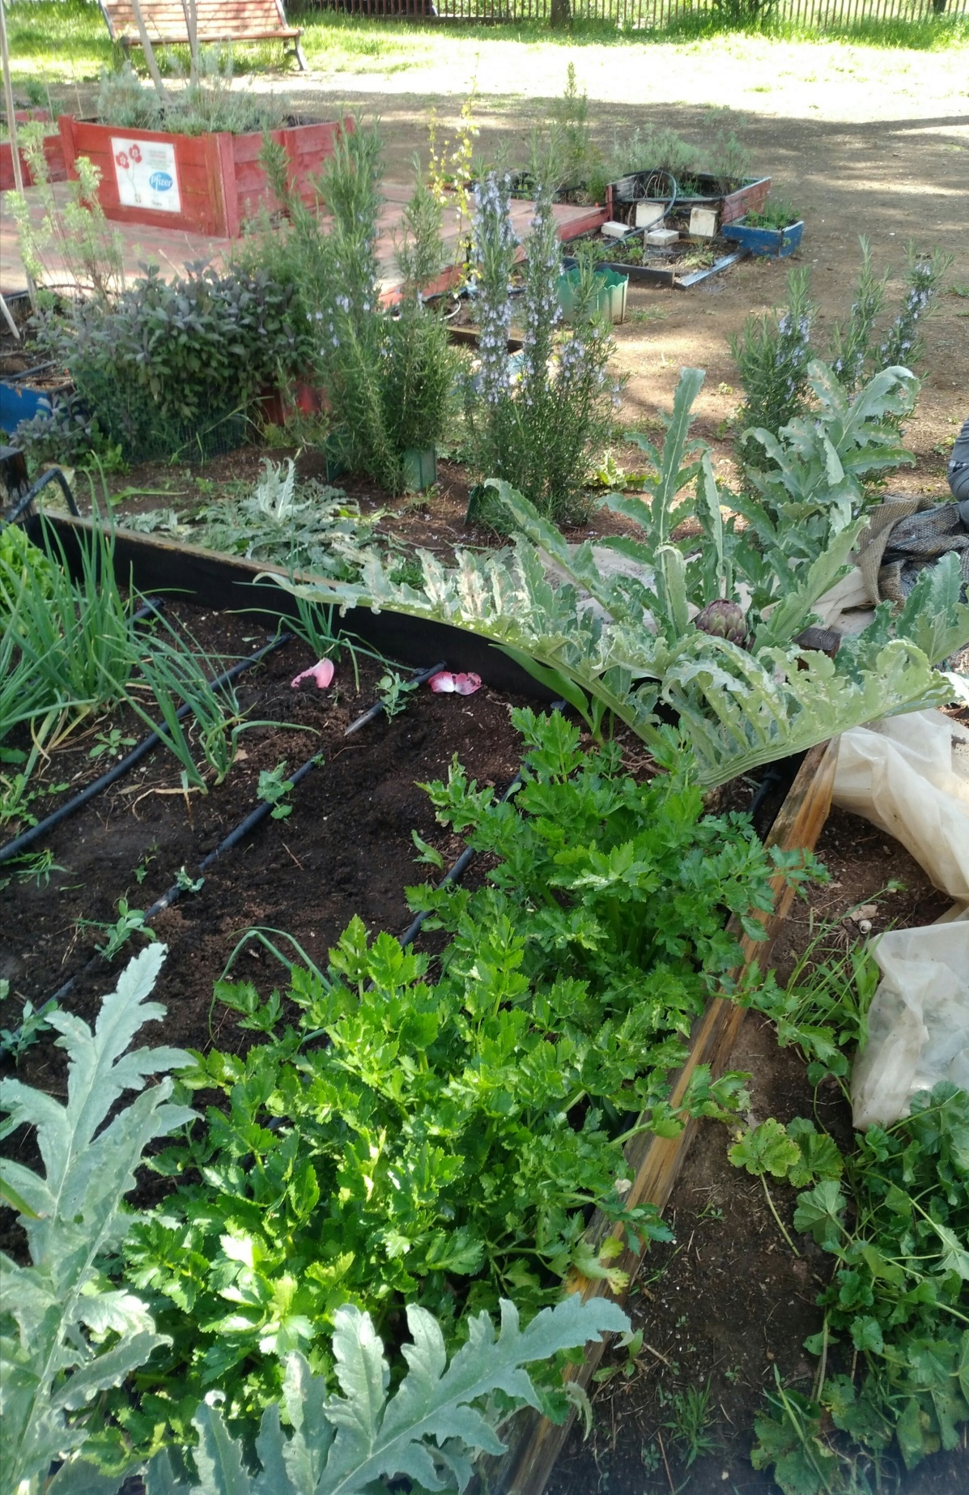
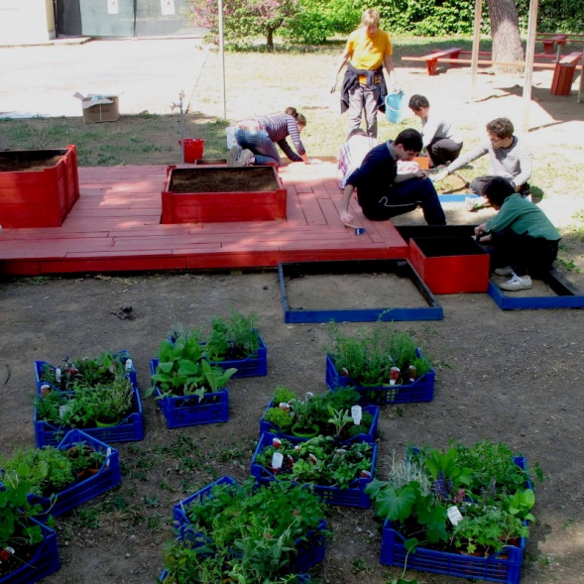
OUR SCHOOL GARDEN
MOREOVER , IN OUR GARDEN, WE CULTIVATE FLOWERS AND VEGETABLES.

Slide 8
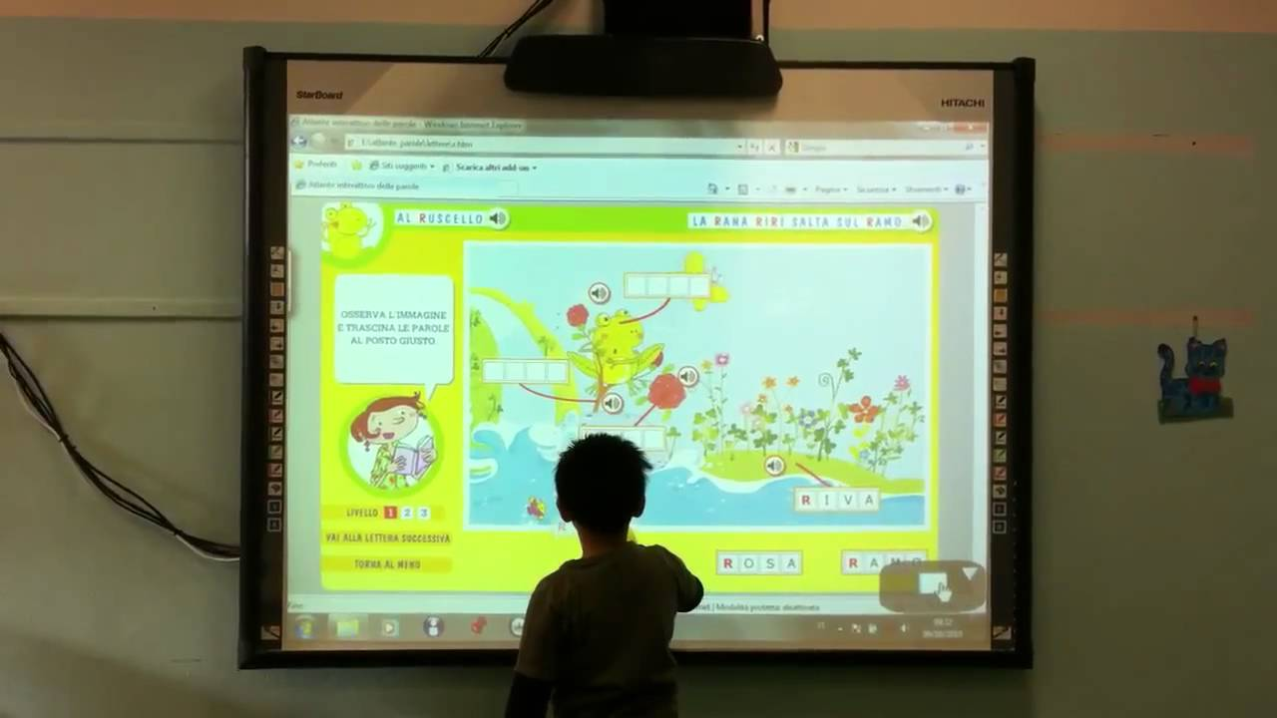
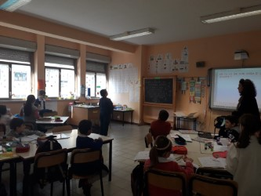
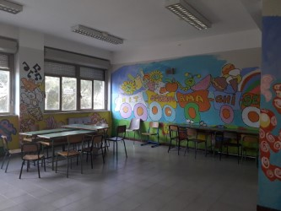
OUR CLASSROOMS
IN EACH CLASSROOM THERE IS AN INTERACTIVE MULTIMEDIA BOARD.

Slide 9
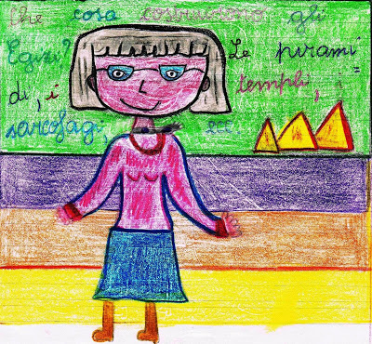
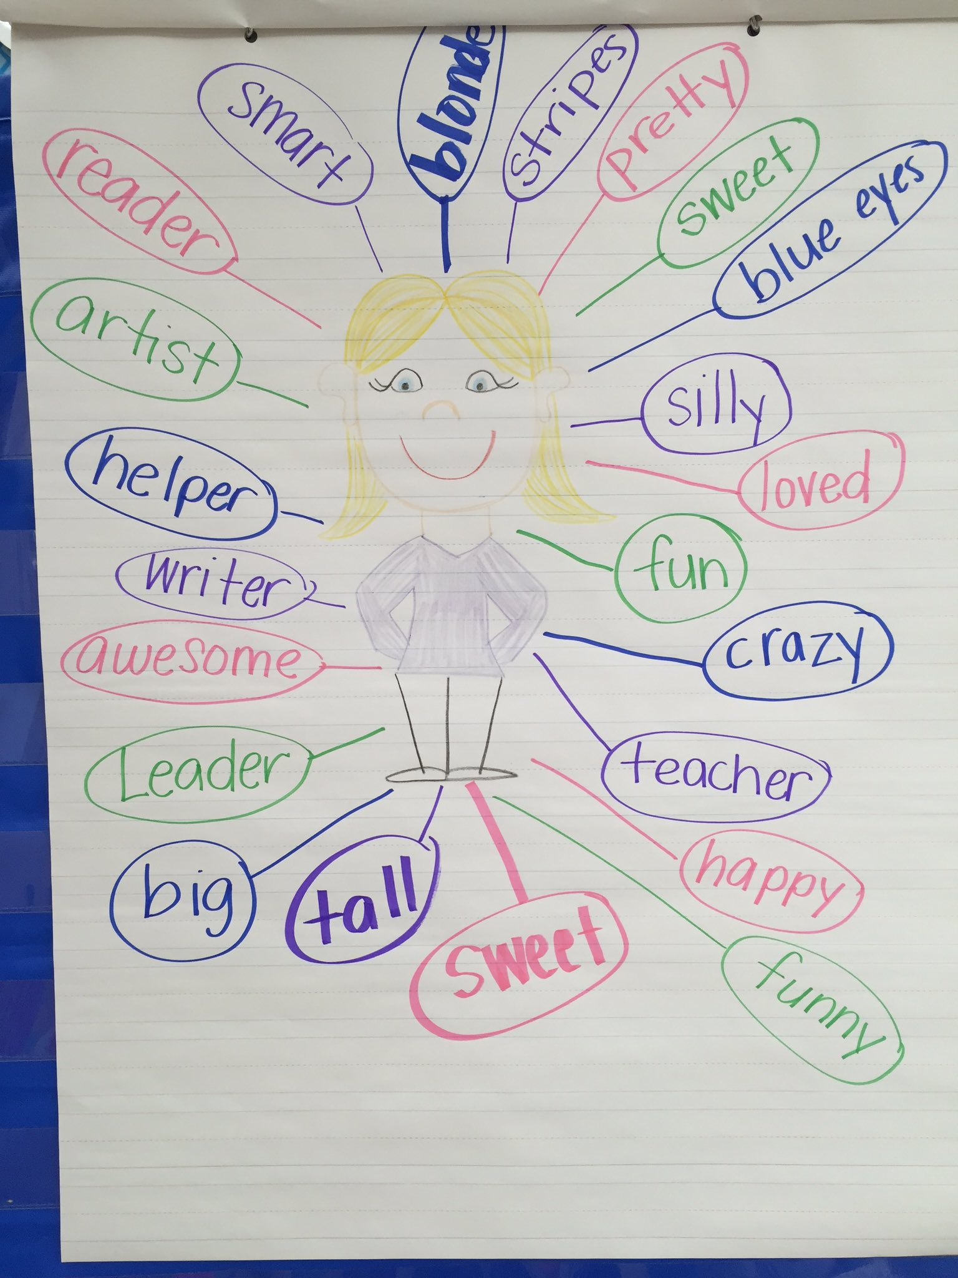
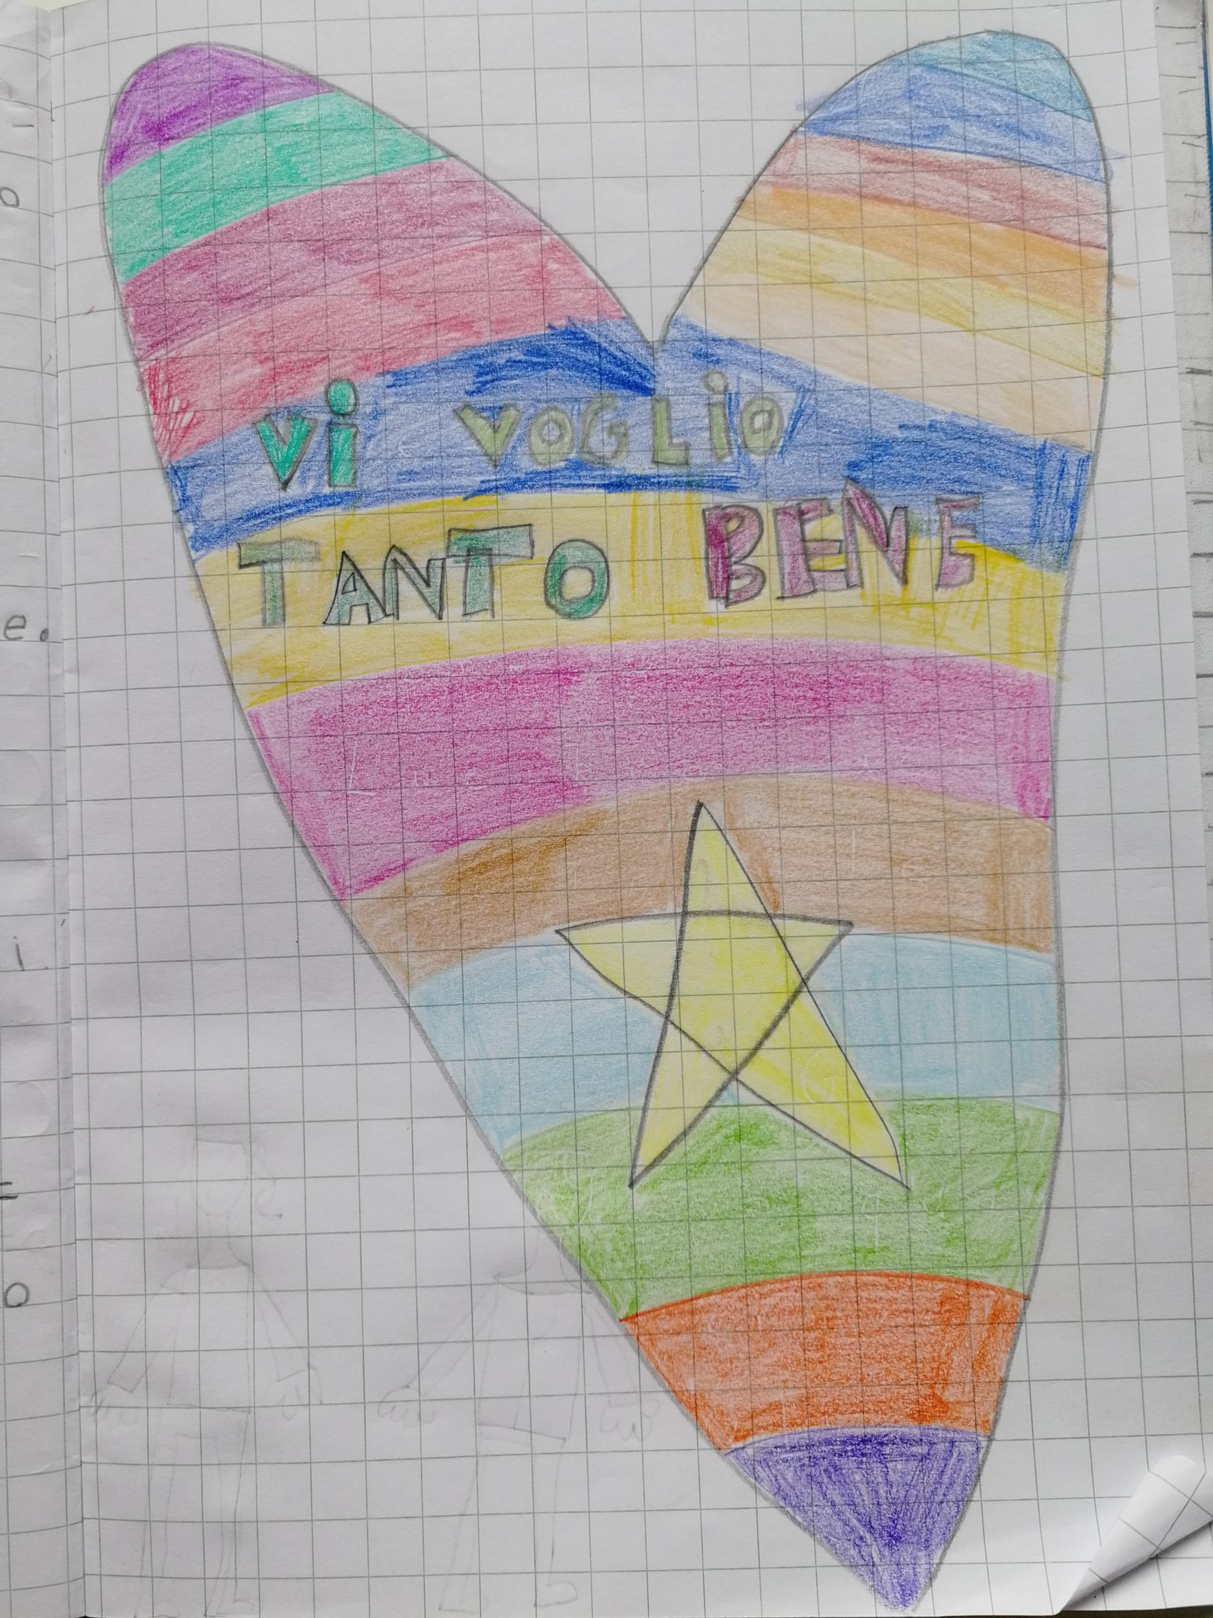
OUR TEACHERS
THERE ARE TWO TEACHERS IN EACH CLASS. THEY ALWAYS GIVE US SOME GOOD ADVICE. WE LOVE THEM!!

