Slide 1




“COME WITH US” eTwinning PROJECT
TOPIC 5: NATURAL PARKS
CLASSI QUARTE – CARDINAL MASSAIA

Slide 2
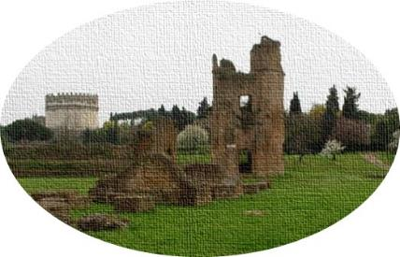
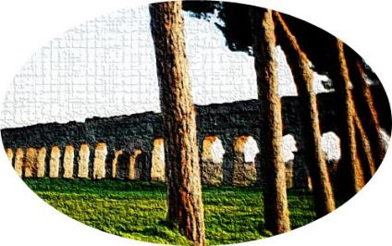
TOPIC 5: OUR NATURAL PARK
Rome, an open-air history book, offers several green areas, enchanting places, a treasure trove of historic villas, enchanting palaces and prestigious vestiges of the past
Appia Antica
Villa Borghese
Parco degli Acquedotti

Slide 3
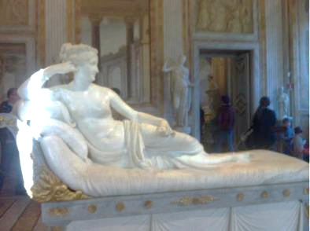
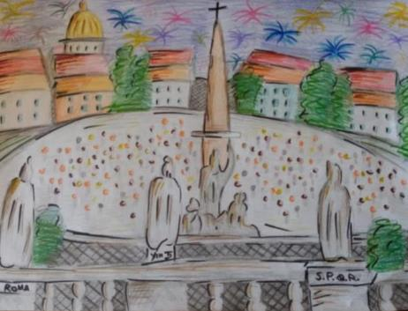
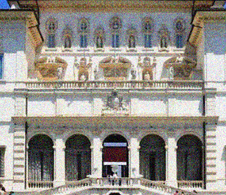
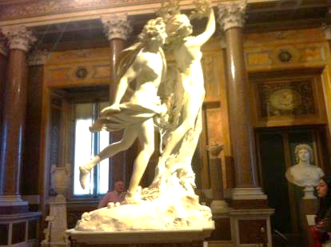
Villa Borghese
Villa Borghese is the green heart of Rome. In the villa, there are statues and fountains of the eighteenth century, important architectures and different types of garden. Inside there is also the Borghese gallery, rich in masterpieces by Bernini and Caravaggio. From the Pincio terrace you can enjoy a unique view of Rome and in particular of the neoclassical Piazza del Popolo.

Slide 4
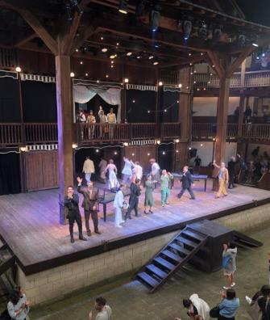
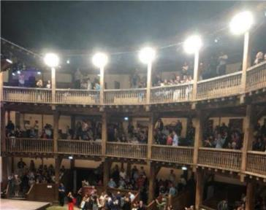
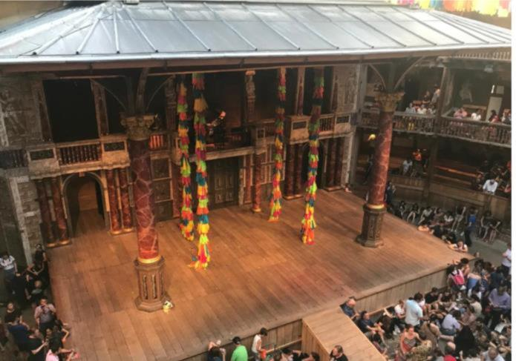
Villa Borghese
Inside Villa Borghese we can admire the Cinema dei Piccoli (the smallest cinema in the world), a toy library with a children's play area at the Casina di Raffaello. A theater in full Elizabethan style, the Globe Theater, built in 2003, entirely in oak wood, reflects the shape of the original theater built in London in 1599 with the covered stage and the area reserved for the public discovered and based on the stages on three levels.
Globe Theatre di Londra

Slide 5
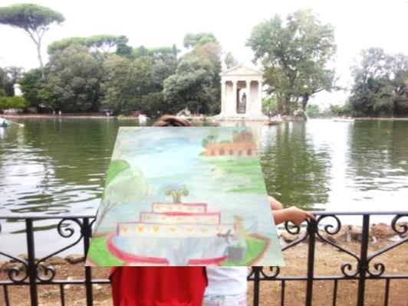
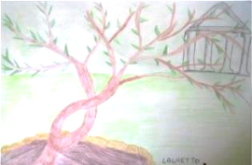
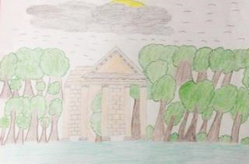
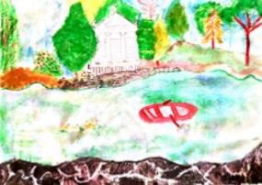
Villa Borghese
In the middle of Villa Borghese there is an artificial lake and an island connected to the mainland by a bridge, where there is the temple of Aesculapius, god of medicine.

Slide 6
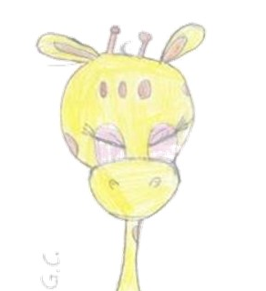
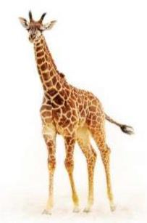
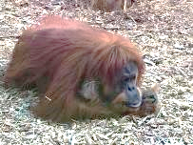
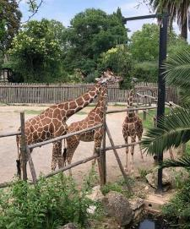
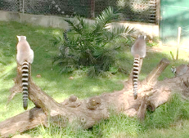
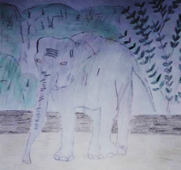
BioParco
The Bioparco was born from the transformation of the historic zoological garden into a natural reserve for the study and protection of endangered animals. Today in this beautiful oasis in the center of the city live about 200 animal species including mammals, birds, reptiles and amphibians from 5 continents.

Slide 7
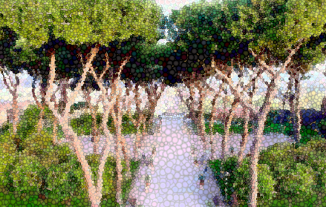

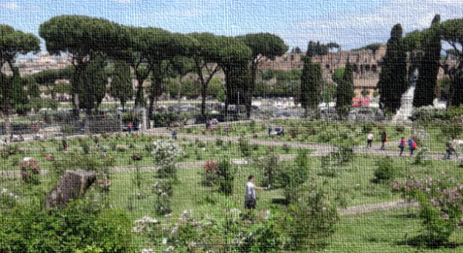



The historical park can be seen as a unique and unrepeatable set of different elements, correlated with each other: buildings and monuments, arboreal, floral and vegetable essences. It's a complex system with forms and architectural, landscape, vegetation and historical-archaeological elements , with the fundamental role of balancing the environment in the development of the contemporary city.
Giardino
degli Aranci
Roseto
Villa Ada

Slide 8
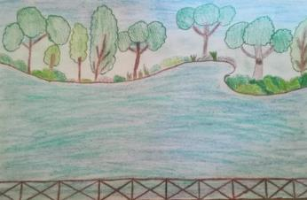
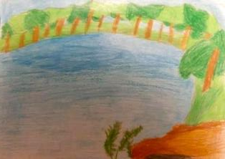
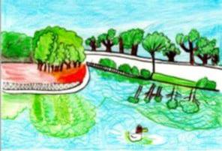
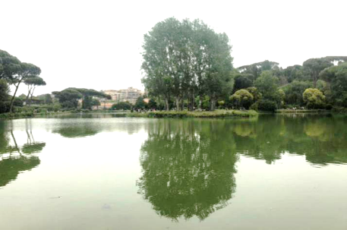
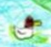
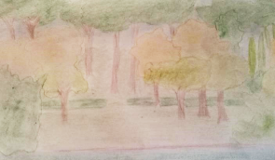
The large park of villa Ada, is characterized by forests of holm oaks, cork oaks, pine forests and meadows, according to the traditional irregular configuration of the English garden, make it an ideal place for walks and jogging in nature there's also a beautiful little lake with a poplar peninsula.
Villa Ada

Slide 9
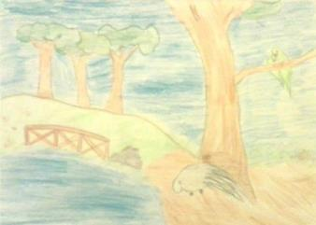
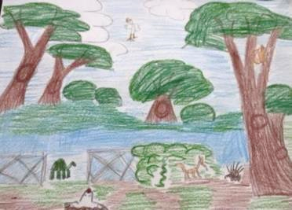
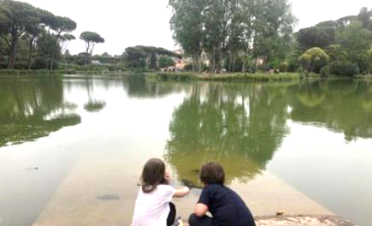
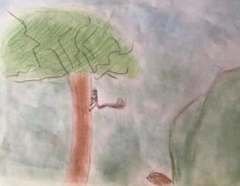
The fauna of Villa Ada is quite rich, there are many squirrels, and also moles, hedgehogs, porcupines, turtles and a rich community of birds like parrots.
Villa Ada

Slide 10
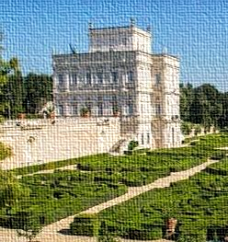
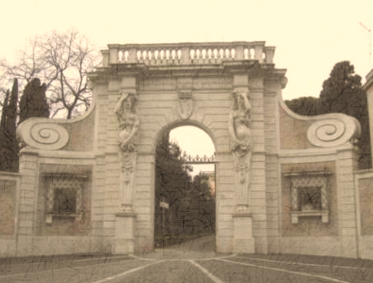
Rome is full of large noble villas with beautiful parks: real open-air museums expression of different artistic eras.
Villa Torlonia
Villa Doria Pamphilj
Villa Celimontana

Slide 11
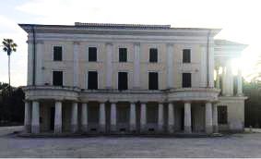
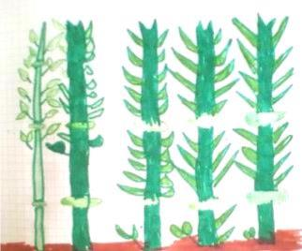
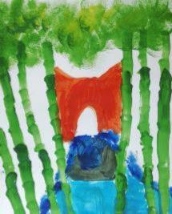
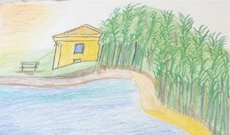
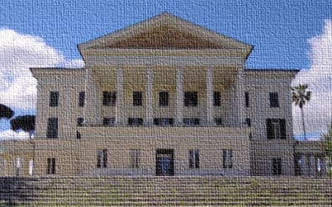
Villa Torlonia
Villa Torlonia, the most recent of the Roman noble villas, still retains a particular charm due to the originality of the English landscape garden and to the rich and unexpected amount of buildings and artistic furnishings scattered throughout the park. The arrangement of the greenery in the southern area of the park followed the taste of the romantic gardens, with the insertion of ponds, irregular avenues and new buildings. There's also a nice little lake in which the bamboo grove is mirrored.

Slide 12
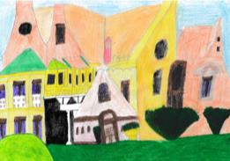
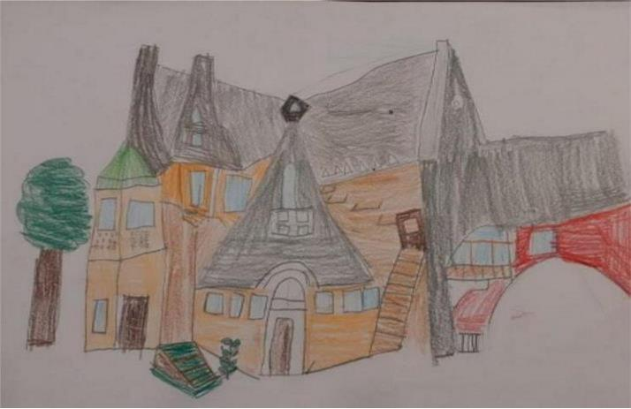
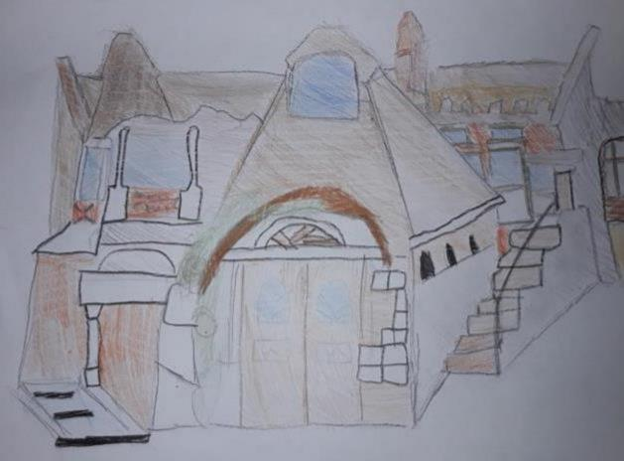
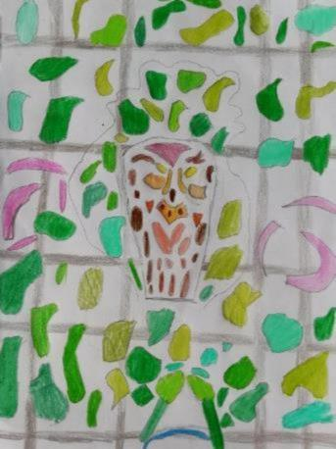
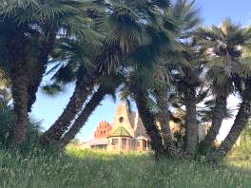
In the villa live holm oaks, bamboo, locust trees, blue palms and California palms; interesting is the presence of ancient chestnut trees and fruit trees scattered throughout the park: figs, cherry trees, plums, apple trees, melangoli. Currently the villa has regained its ancient splendor, offering the public a beautifl exhibition venue: the Casina delle Civette Museum, dedicated to the stained glass window.
Villa Torlonia

