Slide 1


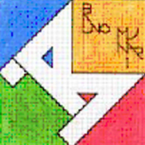

“COME WITH US” eTwinning PROJECT
TOPIC 7:
TRADITIONS AND FESTIVALS: IV - CARDINAL MASSAIA
GASTRONOMY: V B – ANGELO MAURI

Slide 2
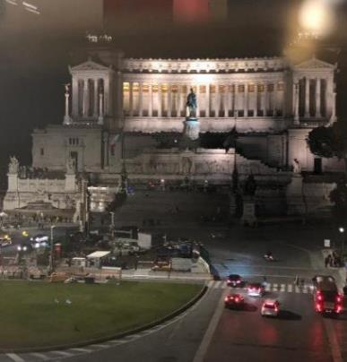
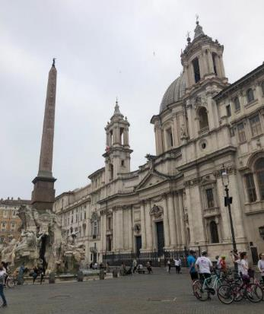
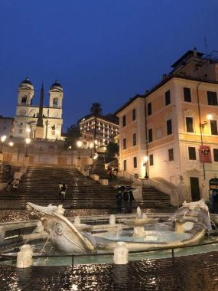
The feasts and festivals of our region are countless, spread throughout the year and full of surprises.
Feasts are, above all, related to religion, but also to the seasons and culinary traditions.
TOPIC 7:
OUR FEASTS AND FESTIVALS

Slide 3
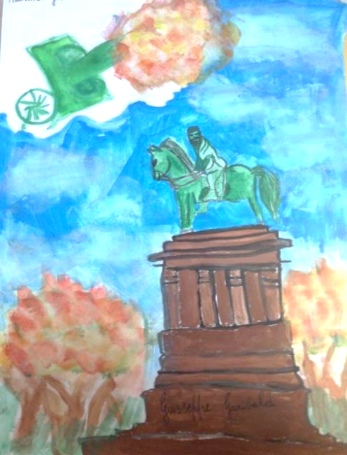
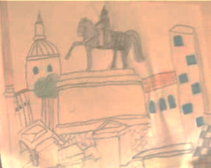
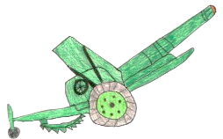
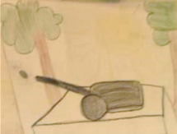
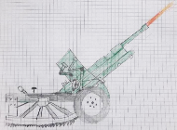
There are things that are repeated precise and punctual, irremovable rites and among these there is the Janiculum cannon in Rome, which from April 21, 1959 every day fires a blank shot at twelve o'clock giving way to all the church bells of Rome, so that they can play in midday in unison. The Gianicolo terrace offers a spectacular panorama over the historic center of Rome, among the most romantic in the city. Here it's possible to admire the busts of the Garibaldi and the mythical statue of Anita Garibaldi on horseback

Slide 4
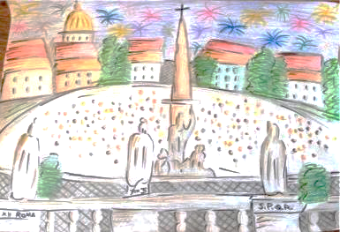
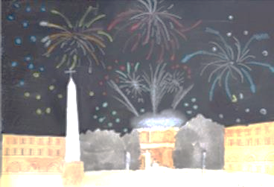
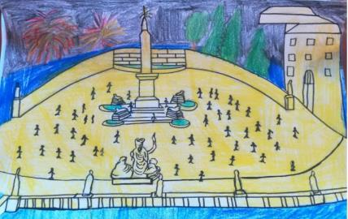
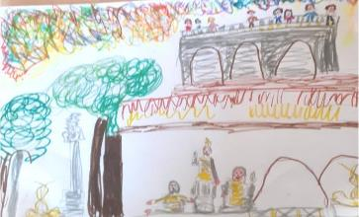
Piazza del Popolo, on New Year's Eve, is filled with celebration for the many people who gather at the foot of the Pincio, around the Flaminio Obelisk (built at the time of Pharaoh Ramesses II) to see the fireworks.

Slide 5
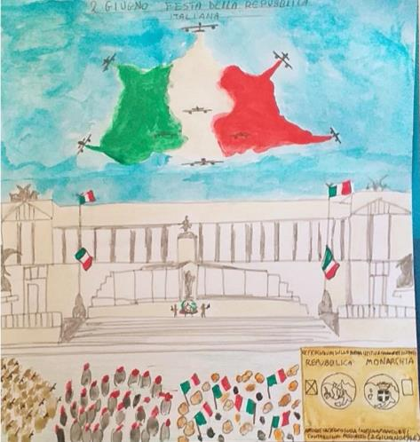
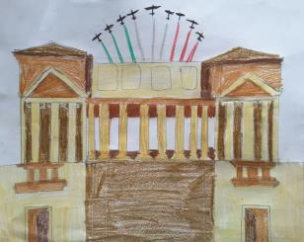
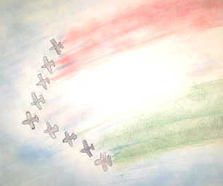

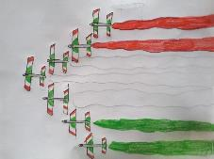
On june 2 the 1946 referendum is remembered,wich after the second worl war sanctioned the end of the monarchy and the birth of the Italian Republic. The ceremonial of the event organized in Rome includes the deposition of a laurel wreath as a tribute to the Unknown Soldier at the Altare della Patria by the President of the Italian Republic, a military parade and tricolor- arrows.

Slide 6
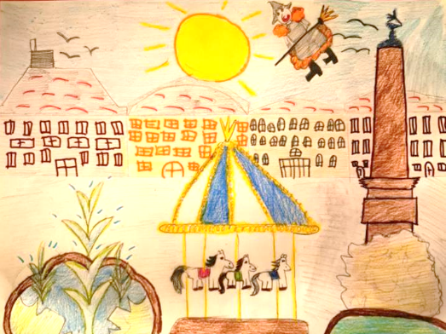
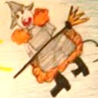
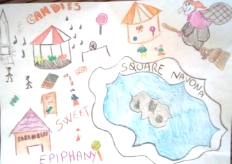
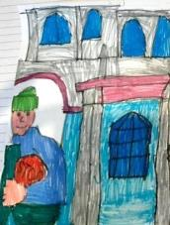
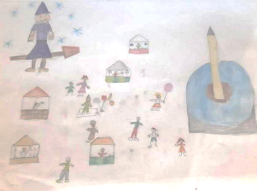
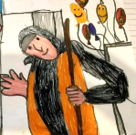
Rome, for Christmas, is colored with lights and decorations, creating a cheerful and beautiful atmosphere. On the occasion of the Epiphany, the Befana Festival is organized in Piazza Navona, an event very dear to Roman citizens who bring their children to meet the Befana every year. The large square, in fact, hosts artists and exhibitionists, as well as thousands of tourists and visitors.

Slide 7


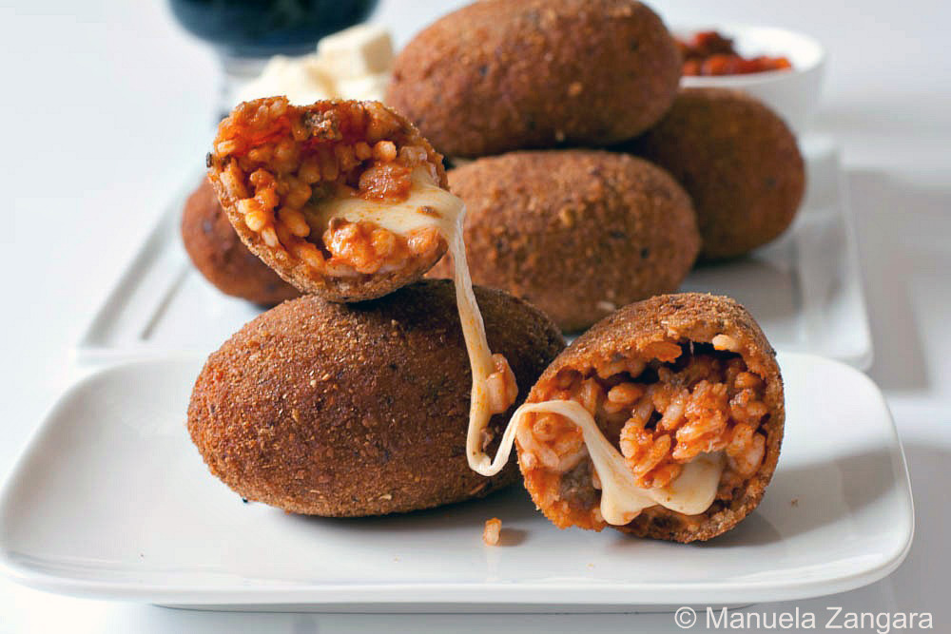
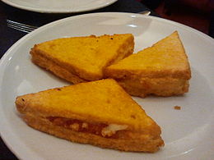
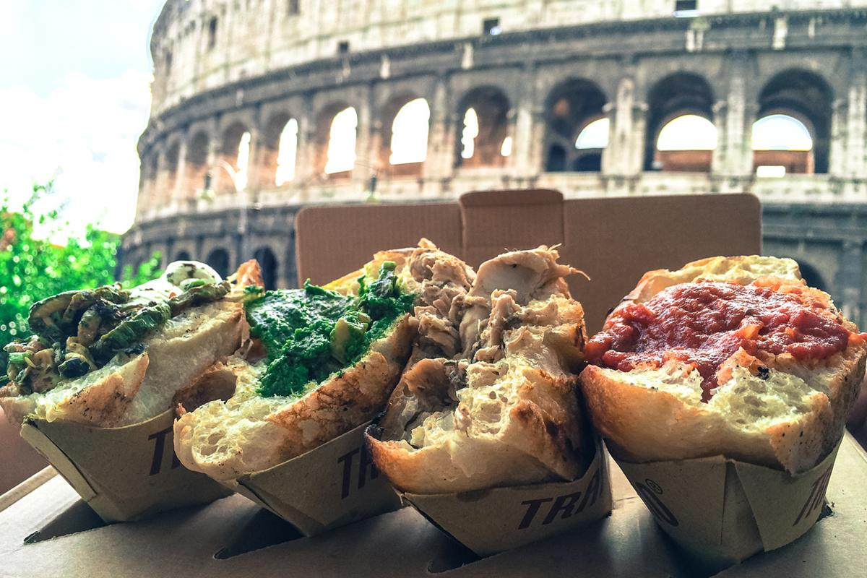
Roman gastronomy
Mozzarella in carrozza (Fried Bread and Mozzarella cheese)
Roman street food trapizzini
Supplì al telefono (Rise balls with mozzarella cheese)
Romans love eating so much!
Let’s start with the appetizers!

Slide 8
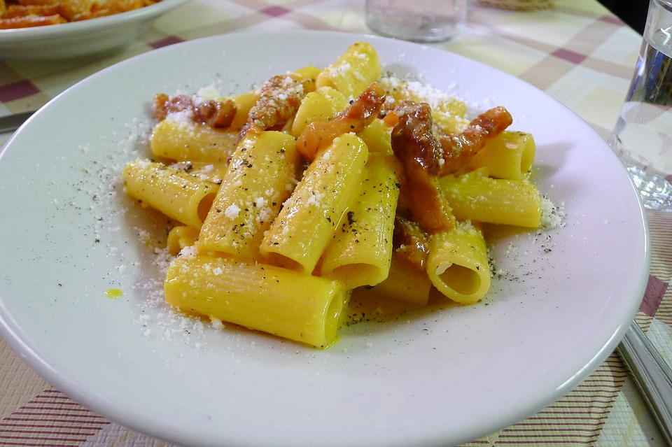
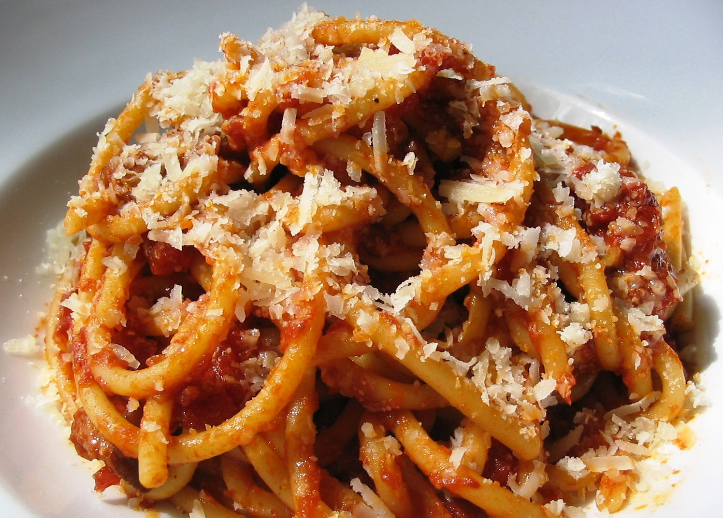
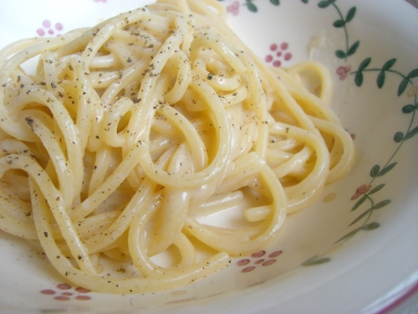
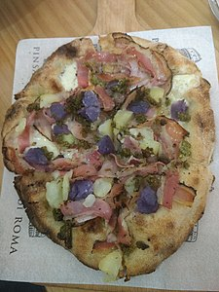
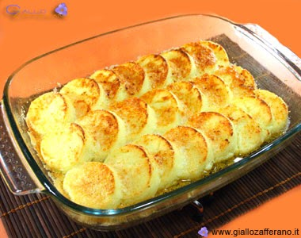
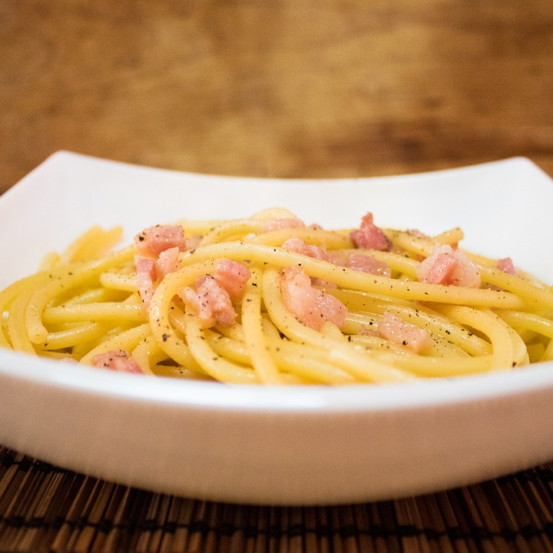
Carbonara
(pork cheek and eggs)
Amatriciana
(with tomato and pork cheek, from Amatrice, near Rieti)
Cacio e pepe
(pecorino romano cheese and black pepper)
Pinsa romana
(from an ancient Roman recipe)
Gnocco romano (semolina dumplings)
Gricia
(like Amatriciana without tomato)
First courses

Slide 9
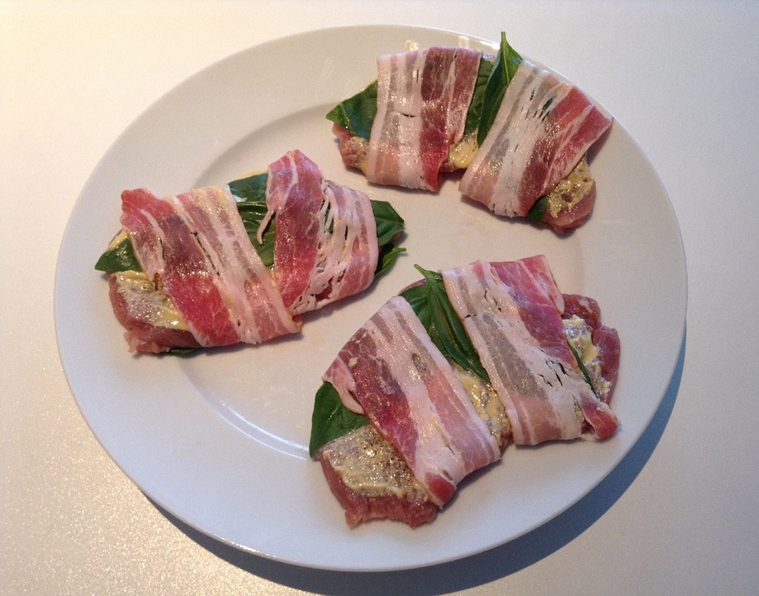
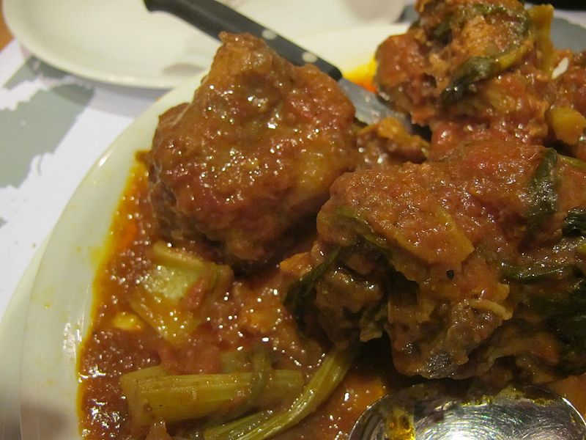
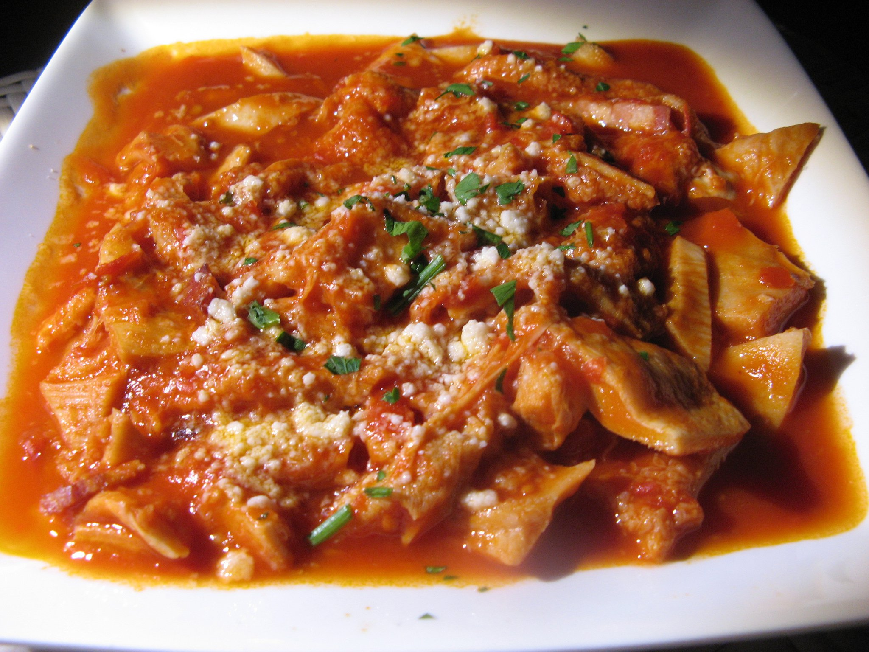
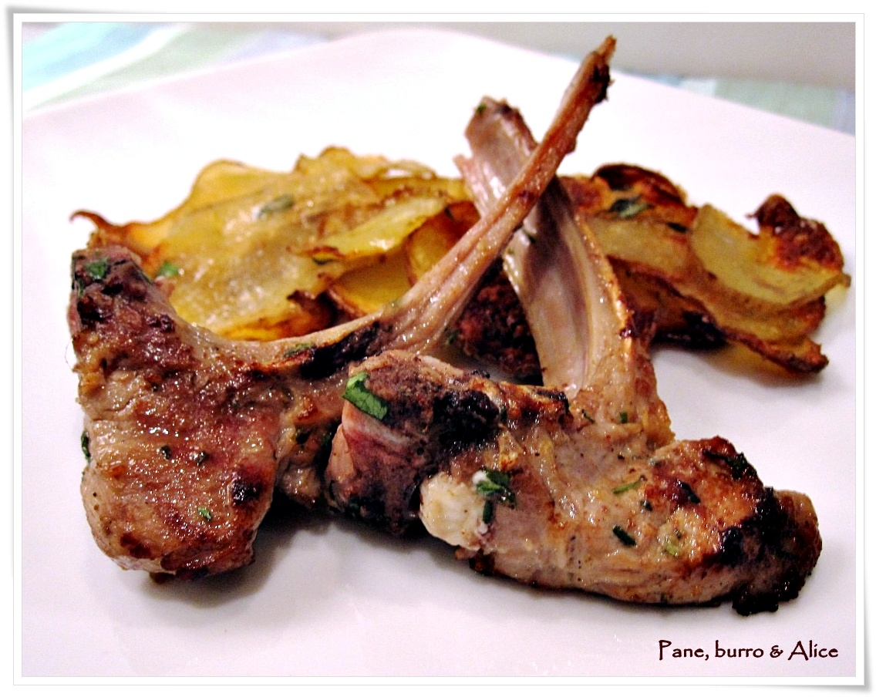
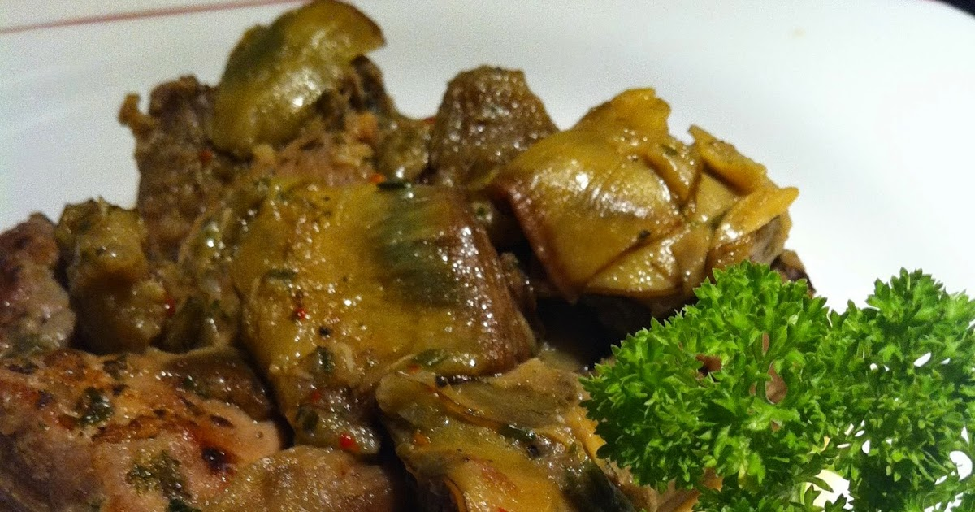
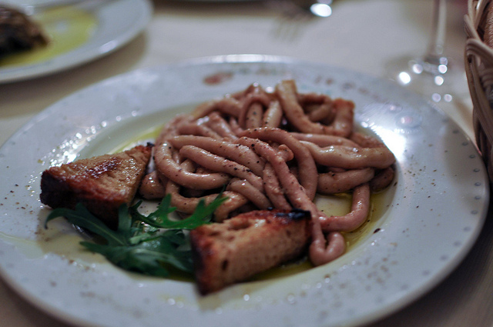
Saltimbocca alla romana (meat, ham and sage)
Coda alla Vaccinara
(Roman Oxtail Stew)
Trippa alla romana
(Roman-style tripe)
Abbacchio alla scottadito (grilled marinated lamb cutlets)
Coratella con carciofi (lamb’s pluck and artichokes)
Main courses
Pajata
(intestines of calf and tomato souce)

Slide 10
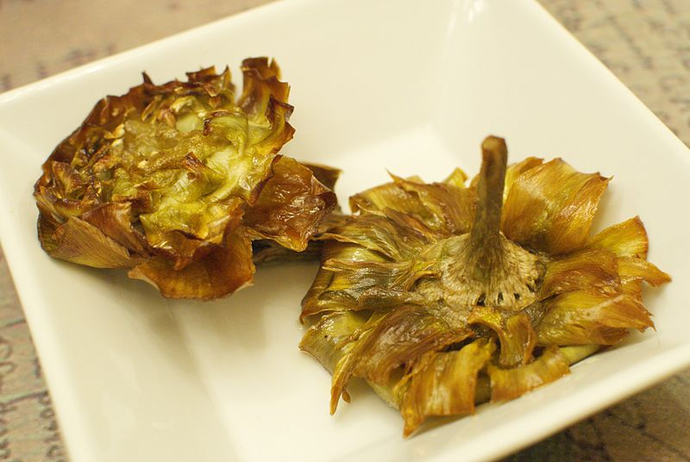
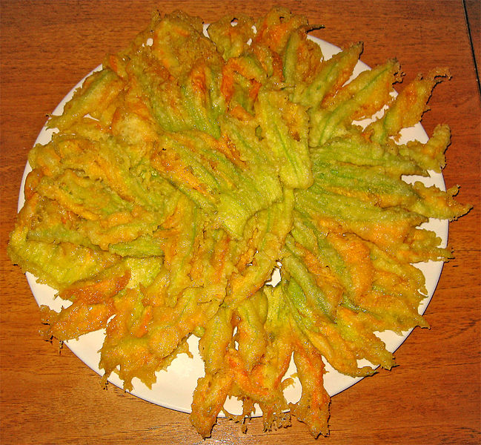
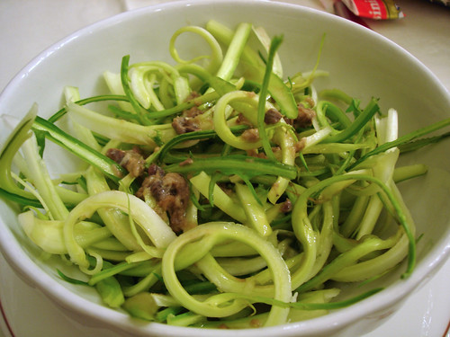
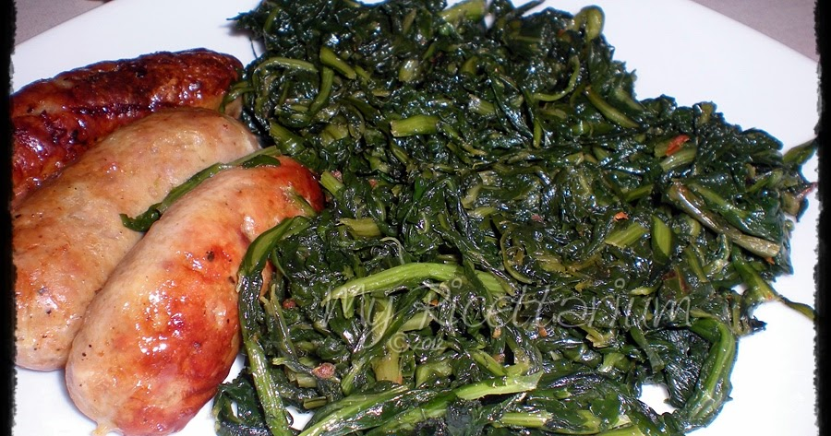
Jewish style artichokes
Fiori di zucca (zucchini flowers filled with mozzarella cheese and anchovies)
Cicoria ripassata
(Chicory sautéed with oil, garlic and pepper)
”Puntarelle”(a variant of chicory with garlic, oil and anchovies)
Side dishes

Slide 11
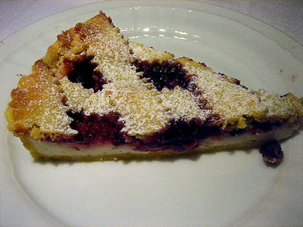
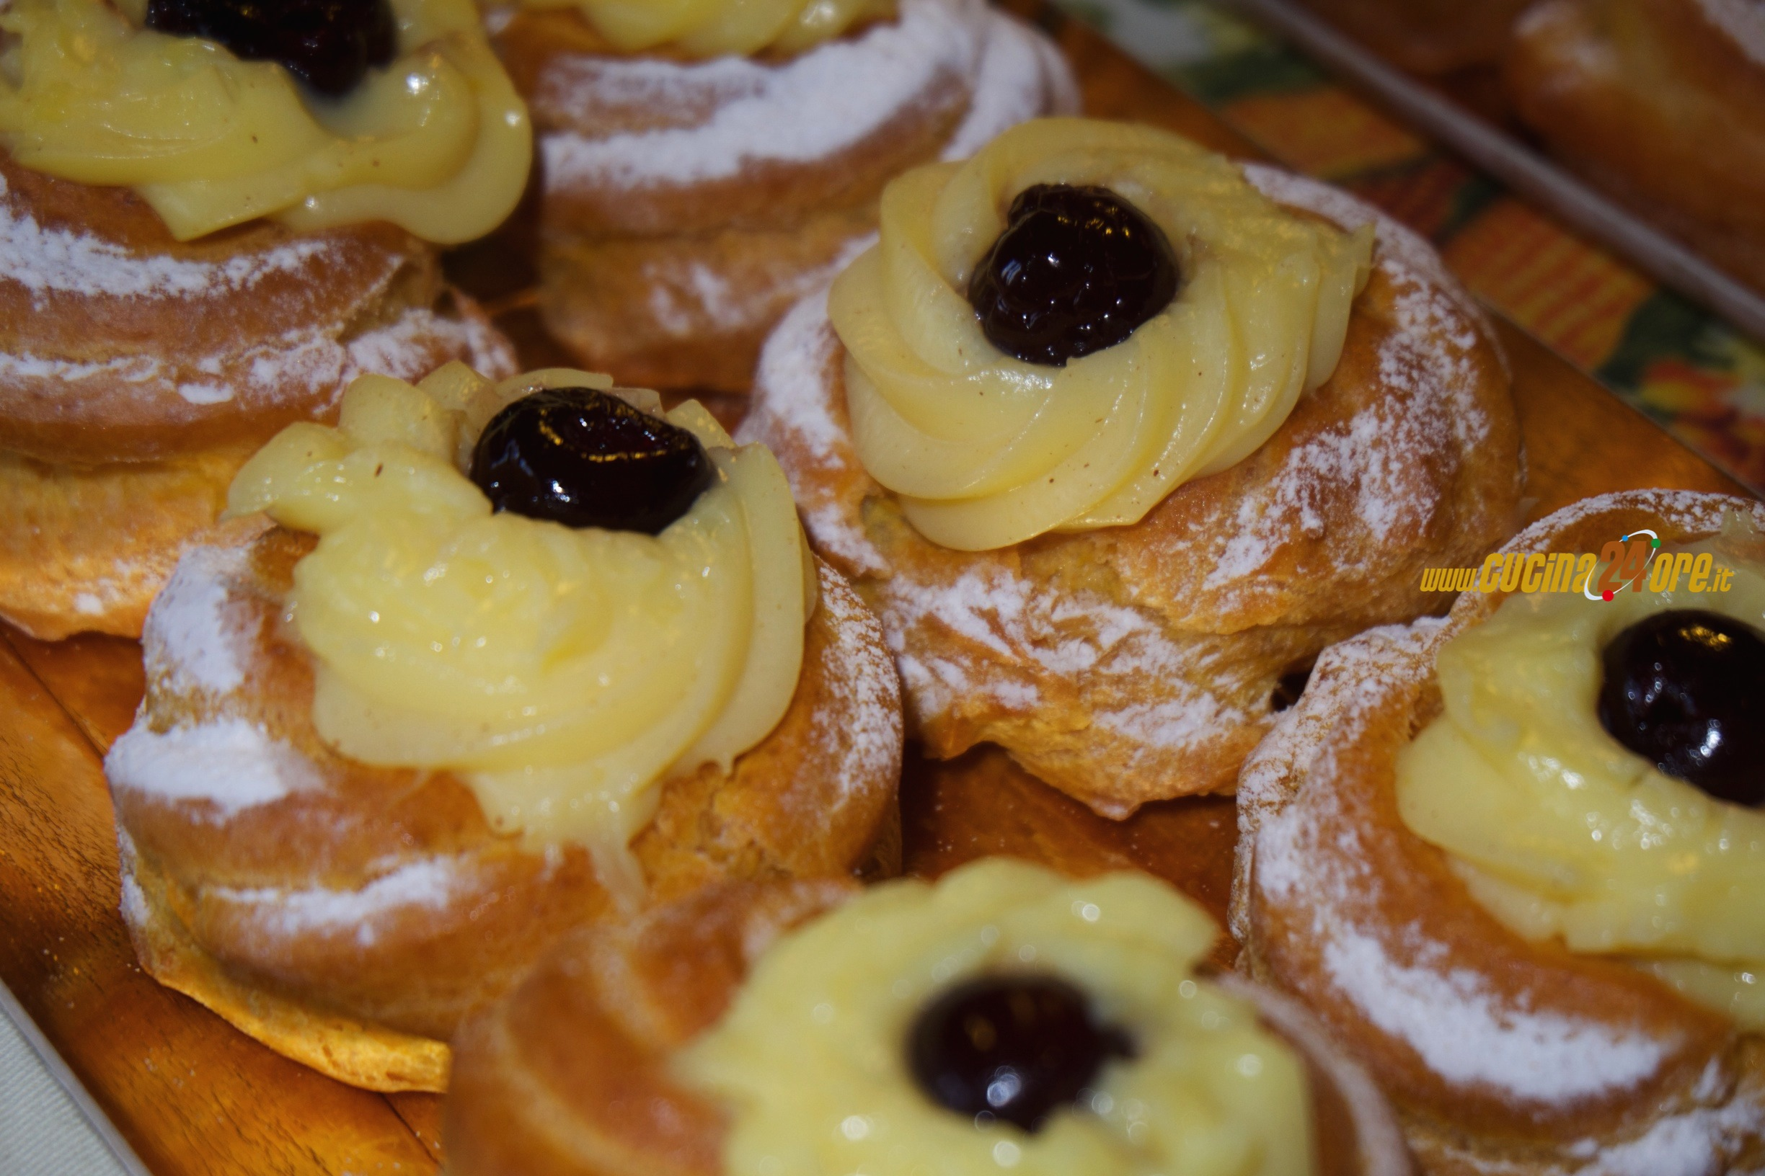
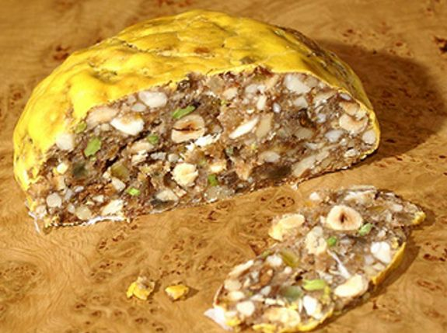
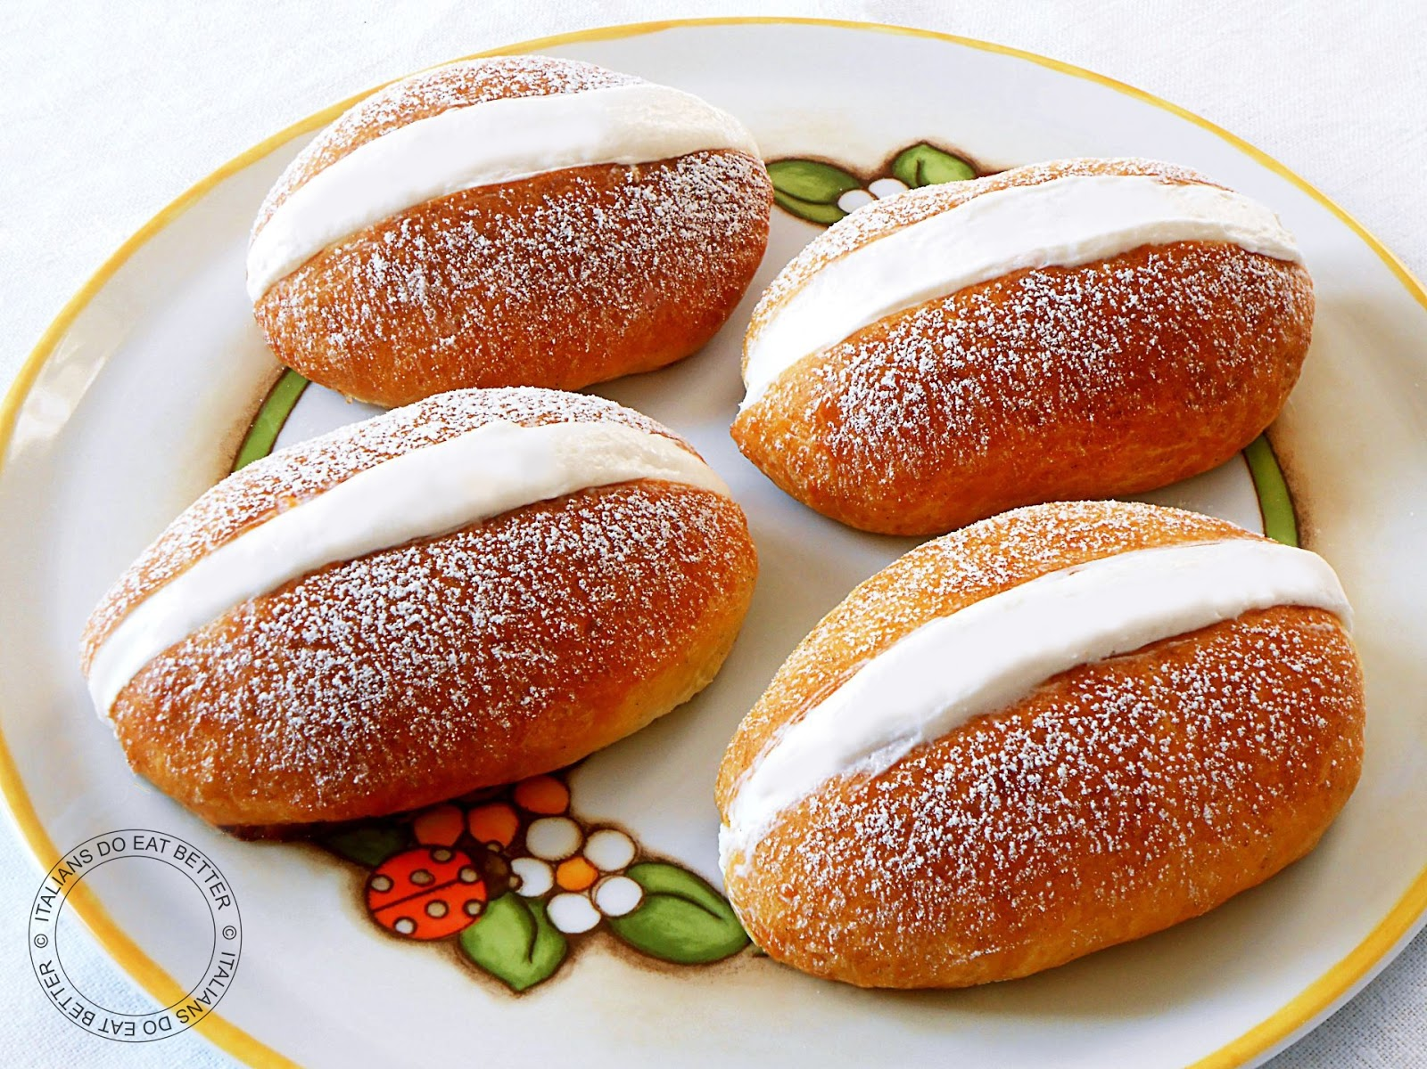
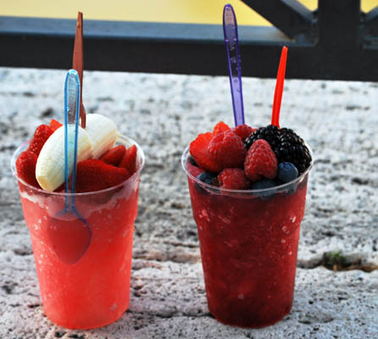
Pangiallo
Crostata ricotta e visciole
(cherry ricotta cheese cake)
Bignè di san Giuseppe
Maritozzo with cream
Grattachecca
(hand-shaved ice flavored with various flavours of sweet sciroppo)
Desserts

